Slide 1
“I had fun, as did my whole family” Contextualising academic literacies in technical writing
Chris Cook
STEPS Head of Program, CQUniversity

Slide 2
Technical Writing for University (TWU)
One of two academic writing units in STEPS
Designed for students intending to study health, science or engineering
On-campus and distance study options

Slide 3
Development of TWU
First developed in 2012
Generic content, except for report topic options
Changes made to assessment tasks in 2013
SAF funding to develop new content in 2014

Slide 4
Brief for SAF Development
Engaging content with topics on health, science and technology
Incorporate activities that facilitate social interactions
Embed skills within topics of interest for students

Slide 5
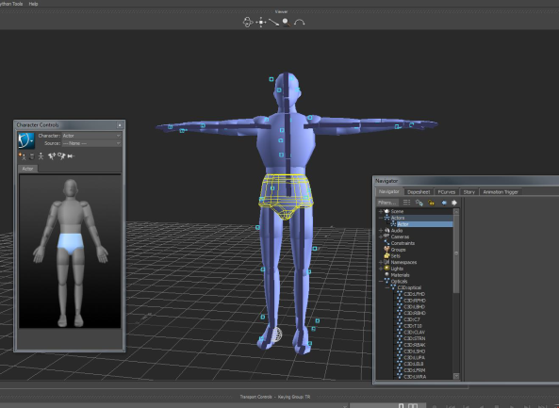
TWU Content
Four modules
Each module three weeks in duration with different topic each week, e.g.
alternative medicine, exo-suits, energy, gizmos

Slide 6
Weekly activities
Four sections:
Discussion – think, write and share
Technical Writing Skills – analyse technical text types
Language Points – vocabulary, grammar, punctuation in context of topic
Assessment Step – scaffolded application of knowledge and skills to assessment tasks

Slide 7
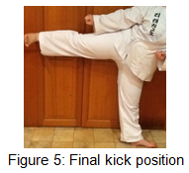
TWU Assessments
Write a set of instructions
Students choose an activity they are familiar with (use students’ existing knowledge)
Seek permission for activity (check engagement)
Test on others (social interaction)
Academic Literacies
Follow explicit format
Consider audience and purpose
Write concisely and consistently using a formal and objective tone
Incorporate figures into a document according to the conventions required by CQUniversity

Slide 8
TWU Assessments
Write an Experimental (lab) Report
Students choose simple experiment from options and add variable(s)
Scaffolded data collection (social interaction)
Academic Literacies
Report writing
Builds on academic literacies of previous assessment

Slide 9
TWU Assessments
Write a Recommendation Report
Students choose recommendation report topic from options and research
Scaffolded information literacy tasks
Academic Literacies
Builds on academic literacies of previous assessment

Slide 10
Outcomes
Students more engaged
Positive feedback from students
Improved academic literacies

Slide 11
Academic Literacies
Lee and Street’s (1998) model of academic literacies attempts to recognise:
Multiple and conflicting literacy practices
Broad communicative repertoires required to switch between genres, fields, disciplines and audience expectations
Literacies as social practices at level of epistemology and identity
Lea, MR & Street, BV, 1998, ‘Student writing in higher education: an academic literacies approach, Studies in Higher Education, vol. 23, no. 2, pp. 157-172.

