Slide 1
Enabling successful persistence with study Developing Academic Literacies
NAEEA Queensland Symposium
George Morrison

Slide 2
The basic research questions
What are the constraints to successful persistence experienced by TPP students?
Social and Academic Integration (Tinto)
Social Reproduction theory (Bourdieu)
How do students overcome constraints to successful persistence?
Ecological theory (Bronfenbrenner)
Personal Learning Ecologies (Jackson)

Slide 3
Constraints
Socio-economic constraints
Non-study commitments
Employment
Family roles and responsibilities

Slide 4
Constraints
Low levels of academic capital
Limited prior experience
Overconfidence
Unrealistic expectations
False beliefs about tertiary level study
Low levels of literacy

Slide 5
Constraints
Low levels of interpersonal capital
Unable to manage social relations (get support)
Difficulties with self-regulation
Difficulties with cooperation and collaborative learning within Microsystem

Slide 6
Constraints
Low levels of communicative capital
Unfamiliarity with university discursive and literacy practices
Difficulties communicating support needs
Difficulties communicating with academics, and vice versa
Difficulties expanding communicative competence

Slide 7
Overcoming Constraints
Personal Learning Ecology
Contexts
Relationships
Learning Ecology
Resources

Slide 8
Overcoming Constraints
Personalise Learning
Set goals

Slide 9
Overcoming Constraints
Personalise Learning
Manage resources
Identify
Access
Utilise

Slide 10
Overcoming Constraints
Personalise Learning
Manage relationships
Assertively communicate learning needs
Adopt inclusive study practices (get significant others involved)
Form new relationships (Social Capital)

Slide 11
Overcoming Constraints
Personalise Learning
Embrace changes (Intrapersonal development)
Emerging identity
Sense-of self
Negotiate roles and responsibilities

Slide 12
Sources of Support
Student | Social Support resource | Area of support
Andy | Older brother | Learning strategies
Ray | Husband | Moral support and encouragement
Cath | brother | Maths
Fred | father | Maths
Sue | boyfriend | Procrastination and Asking for help
Mary | sons | Computer Literacy
Derrick | wife | Language and Literacy
Clara | sister | Conceptual clarification
Catarina | sister | Child minding
Carol | Study group | Clearer explanations
Kev | Work colleagues | Proof reading and grammar
Rob | Work colleagues | Maths
John | Work supervisor | Negotiate work hours/conditions
Walter | Study group | Academic work
Brad | Social forum (then wife) | Clarification
Nat | Social forum, Facebook, classmates | Emotional resilience
Bob | Social forum | Course layout
Petra | Social forum | Clarification and connectedness

Slide 13
Resources used to overcome constraints
Resources | Constraints | Competencies | Lifewide and lifelong learning
Family and significant others Work colleagues Peer study groups Formal meet-ups Social Forum USQ personnel TPP curriculum | Procrastination Low motivation Conceptual difficulties Study habits Discipline knowledge Responsibility conflicts Self-regulation Technical skills | Time and study management skills Computer Formal language use Mathematical knowledge Cultural norms of academia Help seeking behaviour Pragmatic competence in academic discourse | Development of transferable skills such as use of computers, Management of social relations within microsystem Development of resilience Learning to learn in a new cultural situational context Expanding communicative competence

Slide 14
INTERPERSONAL
Relationships
professional
institutional
family
friends
peers
Contexts
Work Place
Virtual Classes
Real Classes
Home
INTRAPERSONAL PROCESSES
Development of
learner identity
nouse
resource manager
relationship manager
self-efficacy
communicative competence
Resources
TPP curriculum
USQ staff and personnel
Family members
Family experiences
Friends
Work colleagues
Work experience
Peer learners
Personal experiences
Example of a Personal Learning Ecology

Slide 15
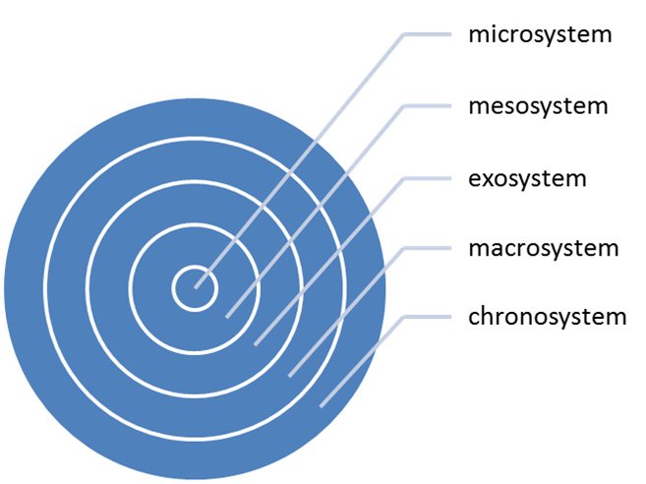
Ecological perspective on retention and attrition

Slide 16
Discussion, clarification and questions
Thanks

