Slide 1
Enabling Education at CQUniversity
STEPS
Skills for Tertiary Education Preparatory Program

Slide 2
A 27 Year History

Slide 3
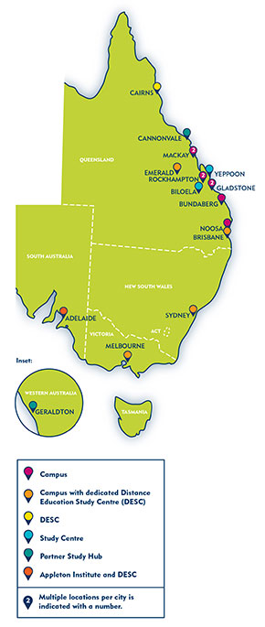
Location
Brisbane
Bundaberg
Emerald
Distance
Geraldton
Gladstone
Mackay
Noosa
Rockhampton
Sydney

Slide 4
2011 Restructure – Objectives for 2012
Provide more flexibility
Improve retention and articulation
Strengthen the course offerings
Handle enrolment more responsibly to ensure ‘assumed’ knowledge acquisition for undergraduate programs

Slide 6
Skills for
Tertiary
Education 2012 →
Preparatory
Studies

Slide 7
Eligibility
Australian and New Zealand citizens
Permanent residents
Holders of humanitarian visas
18 years and over in the year of initial enrolment

Slide 8
Duration
Minimum of 1 term (12 weeks)
Maximum of 6 terms (2 years)

Slide 9
Modes of Study
Full time 3-4 courses/term
Part time 1-2 courses/term
Centrelink approved

Slide 10
Study options
Option 1: Internal (Term 1 and 2)
Option 2: Distance (Terms 1, 2, 3)
Option 3: Combination Internal/Distance (Terms 1 and 2)
* Distance only in Term 3

Slide 11
Application for entry
Applicants apply directly to CQUniversity
Complete a testing and interview process

Slide 12
Entry Requirements
Entrance skills assessment
Literacy and numeracy
Computing readiness inventory
Individual interview
Informed by Personal Writing piece submitted prior to interview
Establishment of Study Plan
Commitment to the program
Diagnostic

Slide 13
Costs
No tuition fees ☺
Textbooks and resources
Available via Moodle
Optional purchase of hard copy texts/study guides at a minimal cost
Students need to purchase
Stella Cottrell’s text
The Study Skills Handbook, 4th edn - $34 available CQUni Bookshop
Stationery, photocopying and printing
Calculator - scientific
Computer costs
Fuel
Day-care
Reduced work

Slide 14
Delivery platforms
Face-to-face, on campus
Moodle – STEPS Program, Courses
Computer Lab sessions
ISL
Blackboard Collaborate

Slide 15
Resources
Course Profile (online)
Study Guide
Text book
Online resources (Moodle)
STEPS Guide for Students and Getting Started with CQUni Systems Guide close

Slide 16
Program structure
1 core course
Preparation Skills for University
11 elective courses
Students are eligible to complete as many elective courses as are required for their individual study plan, based on the applicability of the course content to the student’s undergraduate program of choice.

Slide 17
1 core course
SKIL40025 Preparation Skills for University
Aims to:
help students become self-directed, active and confident learners
encourage students to adopt a critically reflective approach to their studies i.e. time management and goal setting; individual learning preferences and study habits; management of their study and career paths
have students become familiar with the procedures and systems at CQUniversity

Slide 18
11 electives
LNGE40049 Essay Writing for University
LNGE40064 Technical Writing for University
MATH40237 Fundamental Mathematics for University
MATH40228 Intermediate Mathematics for University
MATH40252 Technical Mathematics for University
COIT40206 Computing Skills for University
SKIL40016 Positive Learning for University
PHYS40110 Introductory Physics
BIOL40108 Introductory Biology
CHEM40079 Introductory Chemistry
SCIE40018 Foundation Science

Slide 19
SKIL40025 Preparation Skills for University
This course is designed to help students become self-directed, active and confident learners. It introduces them to a range of theories and concepts to facilitate the development of practical skills and personal attitudes necessary for success in tertiary study. Students are encouraged to adopt a critically reflective approach to all aspects of their studies, including individual learning preferences and study habits; time management and goal-setting; management of their study and career paths; and research. They will become familiar with the procedures and systems that characterise tertiary study, with a particular focus on studying at CQUniversity.

Slide 20
SKIL40016 Positive Learning for University
Through a positive psychology framework, Preparation for Positive Learning introduces students to a variety of concepts and techniques to enhance clarity, optimism, gratitude, strengths, positive relationships, communication skills and healthy living. A mixture of theory, practical activities and reflection demonstrate how personal attitudes and beliefs affect learning and study. Students therefore learn how to think more realistically and flexibly about the challenges they may encounter in higher education. In addition to the content, all course materials are presented online and students are exposed to a number of eLearning (online) tools to actively engage and support their learning.

Slide 21
COIT40206 Computing Skills for University
On completion of this course, students should be able to use a word processor to format the layout of an academic essay and a report. The students should be able to use a spreadsheet to complete a workbook, create simple formula, apply simple functions as well as create and format charts. The students should be able to use the Internet, negotiate a Learning Management System and communicate using email at an academic level. Students should also be able to create a basic Power Point presentation appropriate for university courses.

Slide 22
LNGE40049 Essay Writing for University
On completion of this course students should be able to apply the reading, thinking and writing skills necessary for academic purposes utilising appropriate grammar and writing patterns. Students are familiarised with the stages of the writing process and assisted to apply a range of associated learning strategies. In addition, students develop strategies to plan and write paragraphs, using academic language and conventions. They are introduced to research, note-taking and referencing skills for this purpose. They are also encouraged to examine their own worldviews, and those of others, and to develop critical thinking skills. Students have the opportunity to participate in online discussion forums to support their learning. The course culminates with students planning and writing an academic essay, using independent research skills acquired throughout the course. Reflective practice is integral to the course and this enables students to consider the connection between their personal learning journal and the course outcomes.

Slide 23
LNGE40064 Technical Writing for University
This course introduces students to the writing skills they will need to succeed in university science and technology courses. Students will develop skills in writing clearly and concisely, organising and presenting information in a logical way, and applying relevant conventions of style and grammar. Through intensive reading and writing, they will learn to critically analyse, paraphrase and summarise a range of scientific and technical texts. Students will consolidate their learning by researching and writing a report.

Slide 24
Mathematics suite
MATH40228 Intermediate Mathematics for University
Intermediate Mathematics for University is designed to follow on from a study of introductory mathematical concepts, such as Fundamental Mathematics for University. Students complete core and optional modules, which are chosen according to their future study plans. The course has been developed to provide knowledge of various mathematical topics including statistics, standard deviation, probability, absolute value, inequalities, simultaneous equations, quadratic equations, functions, logarithms, trigonometry, geometry, variation, ratio, proportion, financial mathematics, annuities, series and sequences.
MATH40237 Fundamental Mathematics for University
Fundamental Mathematics for University is designed to provide students with foundation concepts, rules and methods of elementary mathematics. The main aim of this course is to provide the fundamentals of mathematics, which are necessary to develop a unified body of knowledge. Topics covered in the course include operations, percentages, introductory algebra, simple equation solving, exponents, linear equations, introductory statistics and units and conversions.
MATH40252 Technical Mathematics for University
Technical Mathematics for University is designed to follow on from Intermediate Mathematics for University. The completion of both Intermediate Mathematics for University and Technical Mathematics for University prepares students for first year tertiary mathematics in applied science and engineering. The course has been developed to provide knowledge of various mathematical topics including algebra techniques; trigonometric functions, ratios, and graphs; plane and analytical geometry; introductory vectors and introductory calculus.

Slide 25
CHEM40070 Introductory Chemistry
The aim of Introductory Chemistry is to provide you with a foundation in Chemistry for your tertiary study. Chemistry is a language with structure and rules to follow just like the English language. Introductory Chemistry introduces the terms, concepts and rules in chemistry. These concepts have been related to everyday materials and events to place chemistry within the context of your own experiences. This course covers a range of chemical topics, such as matter, molecules, chemical reactions, acids and bases and organic chemistry, as well as introducing the mathematics used in science.

Slide 26
BIOL40103 Introductory Biology
Introductory Biology is the study of living things. It encompasses the cellular basis of living things, the energy metabolism that underlies the activities of life, and the genetic bases for inheritance in organisms. Course also includes the study of evolutionary relationships among organisms and the diversity of life on earth. It considers the biology of micro-organisms, plants, and animals, and it brings together the structural and functional relationships that underlie their day-to-day activities. Introductory Biology draws on the sciences of chemistry and physics for its foundations and applies the laws of these disciplines to living things

Slide 27
PHYS40110 Introductory Physics
This course will prepare student for university study in engineering or the physical sciences. Students will gain an understanding of the basic concepts in physics and learn to apply the principles of physics to solve problems of a physical nature in everyday life. Topics covered in this course include mechanics, electricity, electromagnetism, waves, optics, and atomic physics

Slide 28
SCIE40020 Foundation Science
This course will enable students with no recent formal education in science to gain the necessary understanding of the basic principles of the major branches of science that will serve as a foundation for entry into relevant programs, such as nursing/health, and related areas. Students will develop study skills in selecting and evaluating scientific information. They will also enhance their knowledge and understanding of the fundamentals of biology, chemistry, physics and related mathematical concepts, and their applications in real-world contexts.

Slide 29
Upgrading academic skills
Dual enrolment for current CQUniversity undergraduate students needing to up skill
Course load taken into consideration in establishing a study plan
Specific up skilling needs determine individual study plan

Slide 30
Transition to Undergraduate study
Guaranteed entry to CQUniversity courses dependent on successful completion of courses on the Required Study Plan and the appropriate GPA

Slide 31
Guaranteed entry to Undergraduate study
M:\Campuses\AC Forms & Guides\Interview guides\Guaranteed entry - 23 May 2014.pdf
M:\Campuses\AC Forms & Guides\Interview guides\Quota-based programs 27 May 2014.pdf

Slide 32
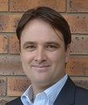
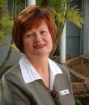
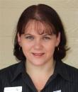
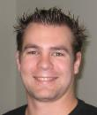
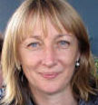
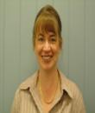
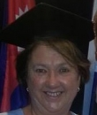
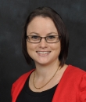
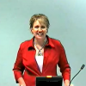
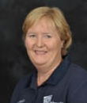
The STEPS Team
STEPS

Slide 33
Please contact for any further information
Chris Cook
Head of Program
07 49707168
c.cook2@cqu.edu.au
Bundaberg
Karen Seary
Associate Dean ALSU
07 41507067
k.seary@cqu.edu.au
Bundaberg

